Slide 1


Slide 2




D0n’t D0 ill3gal Sh1t !

Slide 3

Notes:
Firebug student discount is all week and not just when we go out as a society

Slide 4
WEB APP HACKING

Slide 5
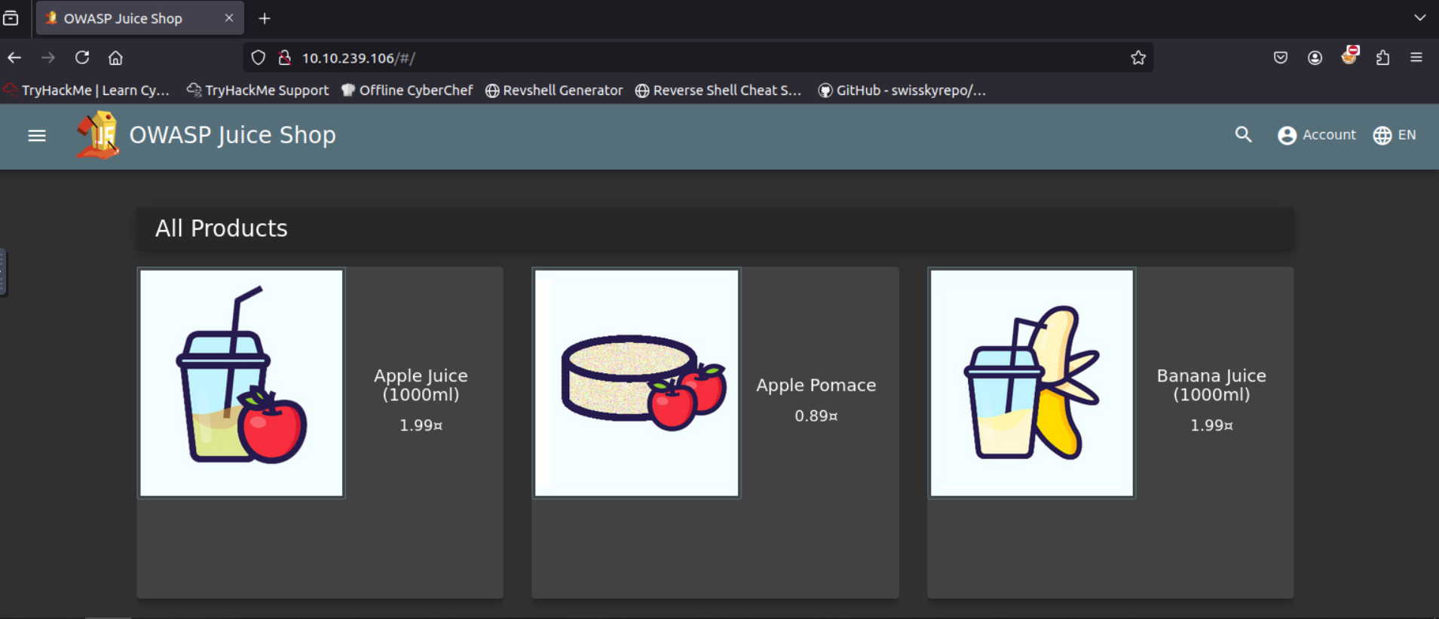
What do?
Notes:
What do we do when presented with something like this?

Slide 6
What do?
Search bar
SQLi, XSS, other reflection methods
Burger menu, more stuff to find
Accounts are a thing, maybe account takeover?

Slide 7
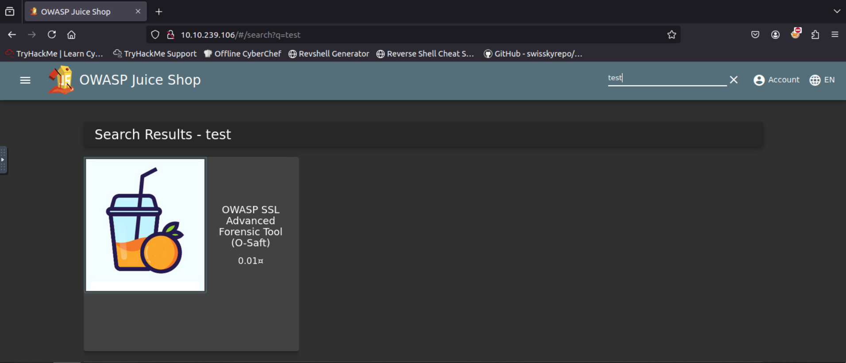
What do?
URL GET parameter, FUZZ IT!!! (or do other attacks… File inclusion :D

Slide 8
What am I waffling about?
Things to look for on websites!
With most websites you can follow the same basic methodology (then expand from there)

Slide 9
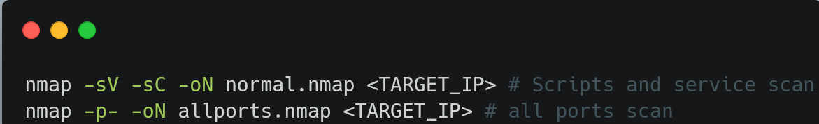
Step 1: Discover website
Check standard web ports + nmap
Port 80: standard HTTP port
Port 443: standard HTTPs port
Port 8080: secondary HTTP port
Nmap will also tell you of any redirects to a virtual host.

Slide 10
Step 1.5: Discover backend
Nmap may tell you what Web server software is being used. E.g. apache, nginx, IIS etc
Use a tool such as Wappalyzer to discover any frameworks or languages used (may be helpful for vulnerabilities)

Slide 11
Step 1.5: Discover backend
If you discover vulnerabilities in the software, continue as normal but keep in mind. For example, if a framework has a Server-Side Template Injection (SSTI) vulnerability, look out for places you can exploit it (covered in Step 4)

Slide 12
Step 2: Manual crawl
Click every link you can see on the website, make notes of where you have accessed and build a sitemap (Burpsuite useful here)

Slide 13
Step 3: Fuzz you Fool
Use a fuzzer such as ffuf to fuzz for directories/vhosts on the website
(vhosts only applicable when IP resolves to a domain)
Use a wordlist designed for fuzzing, start with a small one then get bigger. Maybe consider some file extensions as well.

Slide 14
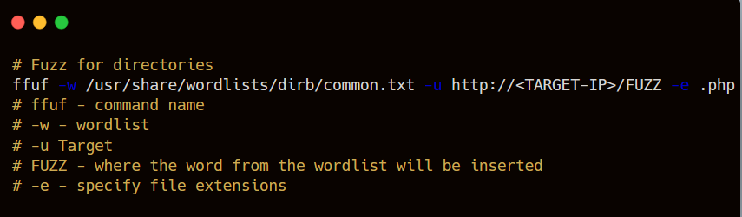
Step 3: Fuzz you Fool

Slide 15
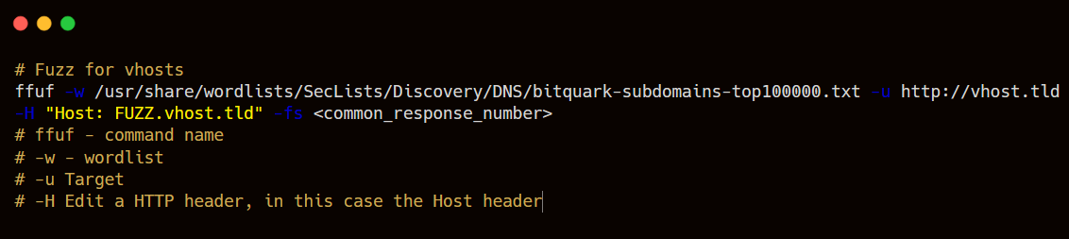
Step 3: Fuzz you Fool

Slide 16
Step 4: Find entry points
An entry point is anything you can type into
e.g.
GET parameters
POST parameters
Search box
Contact form
File upload

Slide 17
Step 5: Identify what do
Find out what they do
Does the search echo back to you what you type in?
Does the search return a list of stuff based on what you type in?
Does it give you a new page?

Slide 18
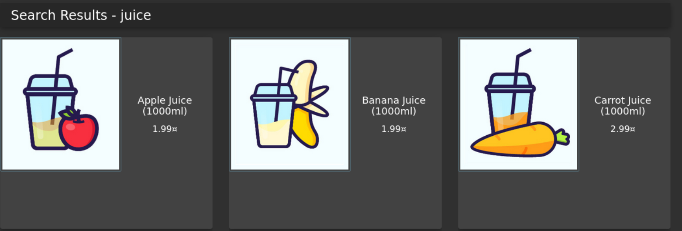
Step 5: Identify what do
Search results for juice, what happens if I search
<img src=x onerror=alert(1)>

Slide 19
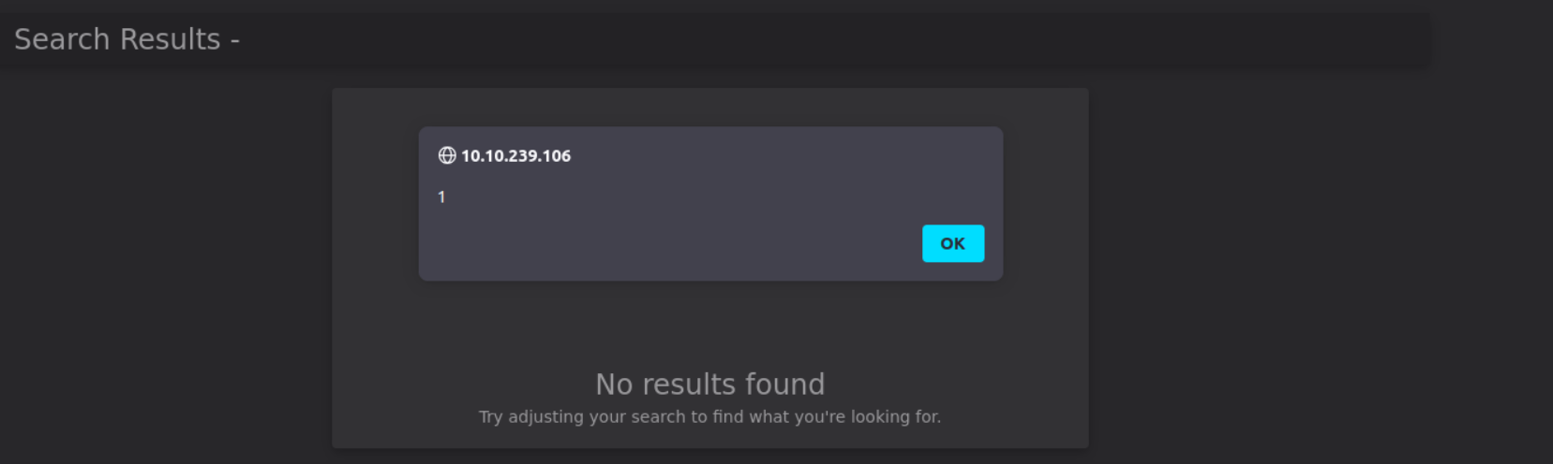
Step 5: Identify what do

Slide 20
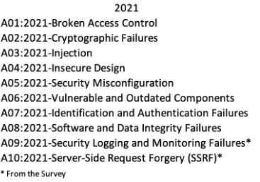
OWASP 10

Slide 21

BurpSuite

Slide 22
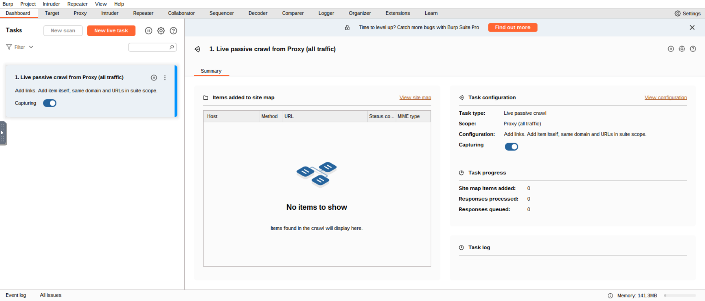
BurpSuite
Web app swiss army knife.
Learn how to use this, will make your life much easier.

Slide 23
BurpSuite
In my opinion, most important parts:
Proxy – Catches web traffic in flight, can modify it as well
Repeater – allows you to easily modify and resend the same request
Target – allows you to build a sitemap of the target and retains your HTTP history.

Slide 24
Brief DVWA Demo for the purposes
of showing you
lovely people how
BurpSuite works on a real website

Slide 25
BurpSuite Instructions
Open firefox
Click the FoxyProxy extension (top right of screen)
Click “BurpSuite”
Open BurpSuite
Profit

Slide 26
BurpSuite Instructions
if not setup
Open firefox
Navigate to addons store
Search “FoxyProxy” and install
Click the extension in the top right and click options
Click “Proxies” then click “add”
Set the title to “BurpSuite”
Hostname: 127.0.0.1
Port: 8080
Save
Click extension and click BurpSuite
Open BurpSuite
Navigate to http://burp
Click CA Certificate
Install CA Certificate (Instructions for firefox here)

Slide 27
Additional tools/stuff
https://github.com/danielmiessler/SecLists - (sudo apt install seclists on kali)
https://www.freecodecamp.org/news/web-security-fuzz-web-applications-using-ffuf/
https://www.youtube.com/watch?v=dQw4w9WgXcQ – Useful tutorial for practical
https://owasp.org/
https://portswigger.net/web-security/dashboard - Good learning for web stuff need account)

Slide 28
Additional tools/stuff
Common attacks to research:
XSS (Reflected, Stored, and DOM based)
SSRF/CSRF
SSTI
SQLi/NoSQLi
File disclosure / Local|Remote File Inclusion
File upload vulnerabilities
Business Logic Flaws
Authentication Bypass

Slide 29




Your turn!
https://tryhackme.com/r/room/owaspjuiceshop

